Slide 1
Developing Location-Based Advertising in Kimathi University Martin Nganga

Slide 2
Introduction
LBA = LBS + Advertising

Slide 3
Problem Statement
Small Businesses
Traditional Advertising = Expensive, Location Precision?

Slide 4
Objectives
General
To develop Location-Based Advertising (LBA) at Kimathi University
Specific
To review existing LBA services and identify factors critical to their success
To apply the success factors and develop an LBA for the Kimathi context
To assess the performance and utility of the LBA

Slide 5
Significance of the Study
LBA allows:
Targeting of advertisements to customers at a precise location
Vendors to reach customers in proximity to their businesses
Simple advertisement creation; reduced cost
Determining advertisement traction

Slide 6
Scope of Work
Kimathi Small Businesses
Pull Mobile LBA
Peer to Peer Messaging

Slide 7
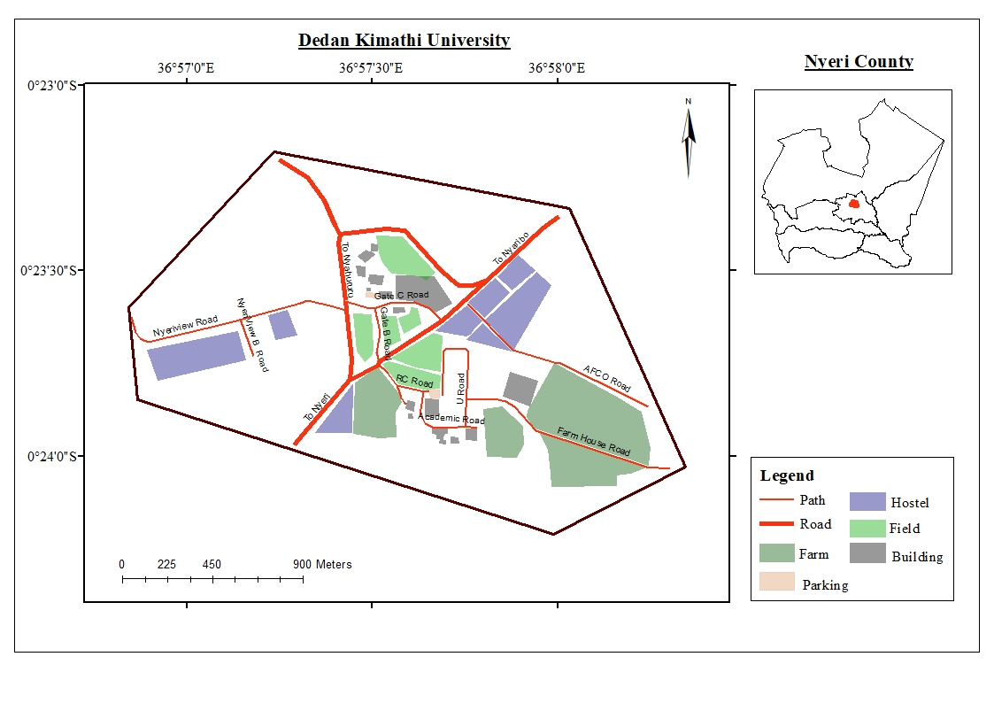

Slide 8
s/n | Data Type | Specifications | Source | Use
1 | Geotagged ad | Ad tagged with (x, y) | User-generated | User intention at (x, y)
2 | P2P messages | Text | User-generated | Feedback
s/n | Tool | Specifications | Source | Use
1 | Laptop | Ubuntu 18.04 | Personal | Server configuration
2 | Mobile Devices | Android 4.0+ | User owned | Development & Data collection
s/n | Software | Version | Source | Use
1 | Android Studio | 182.5314842 | developers.android.com | Building the user interfaces
2 | Flask | 1.0.2 | flask.pocoo.org | Writing the backend APIs
3 | ElasticSearch | 7.0.0 | elastic.co | Provide search
4 | PostgreSQL | 11.2 | postgresql.org | Archiving the data
5 | Heroku | n/a | heroku.com | Hosting the server

Slide 9
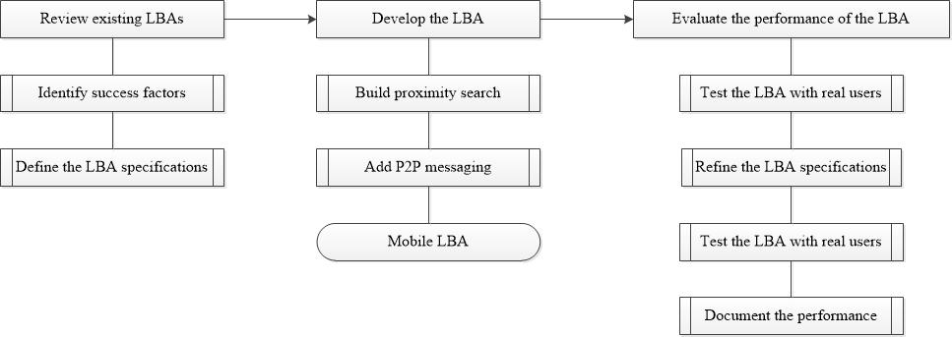

Slide 10
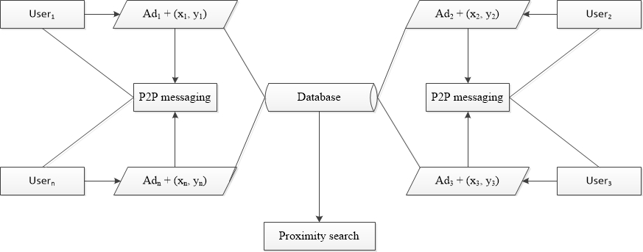

Slide 11
Results: Objective One (Blueprint)
Pull Approach - Unstable Internet Connection
Crowdsourcing - Reduce Advertisement Creations Cost
Effective Feedback - Traction + Buyer-Seller Communication
Focus on Users not Products - Trust
Ranking Based on Proximity - Location Congruency

Slide 12
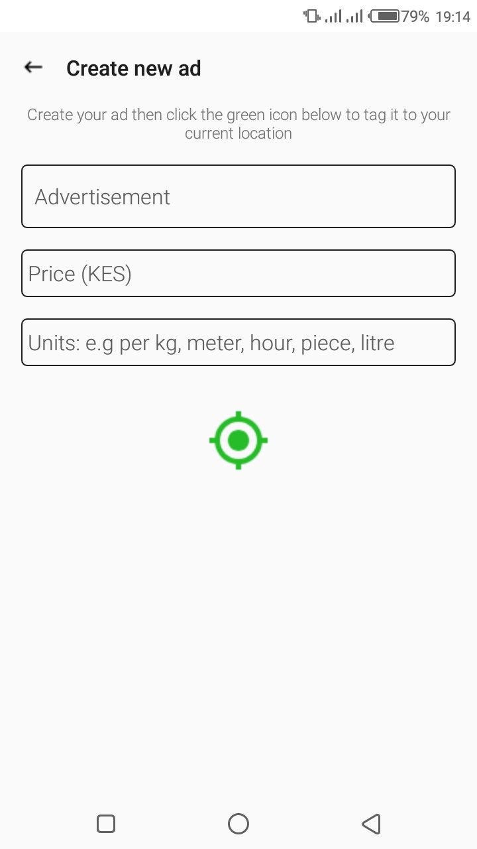
Results: Objective Two (Development)

Slide 13
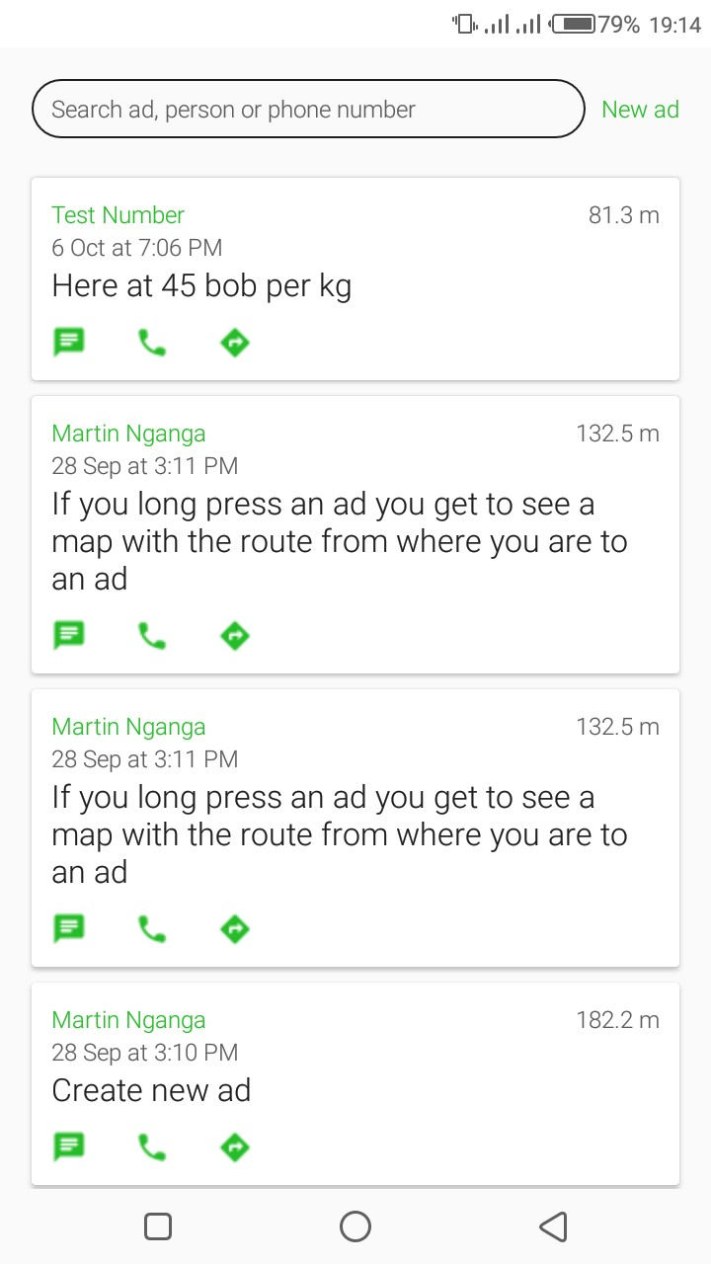
Results: Objective Two (Development)

Slide 14
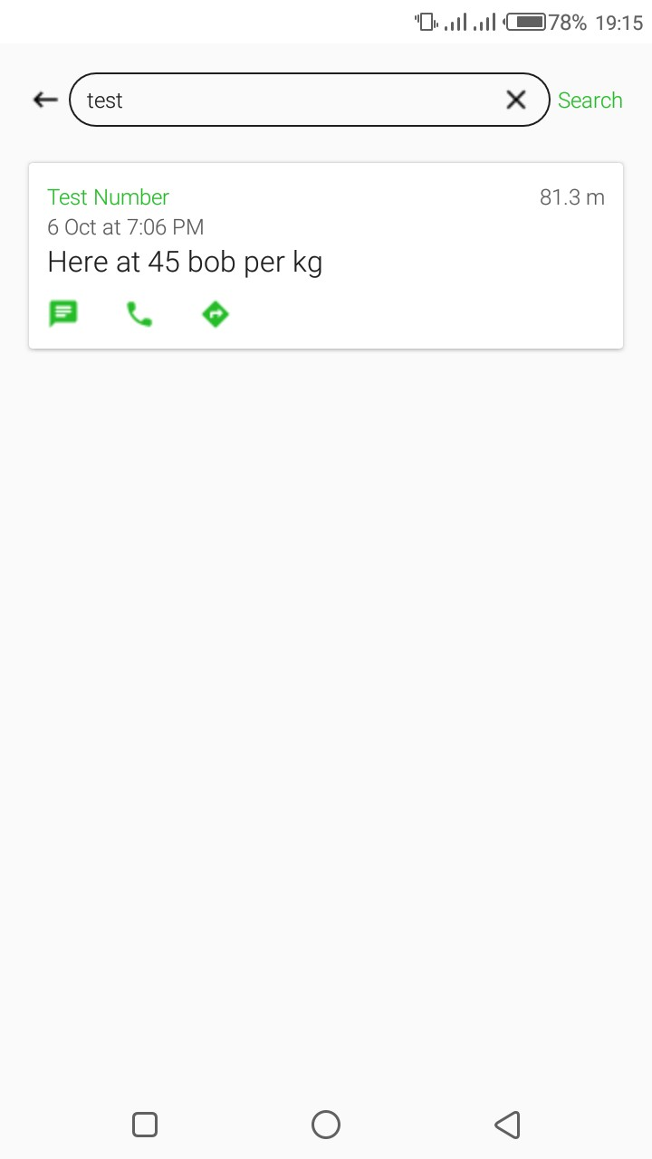
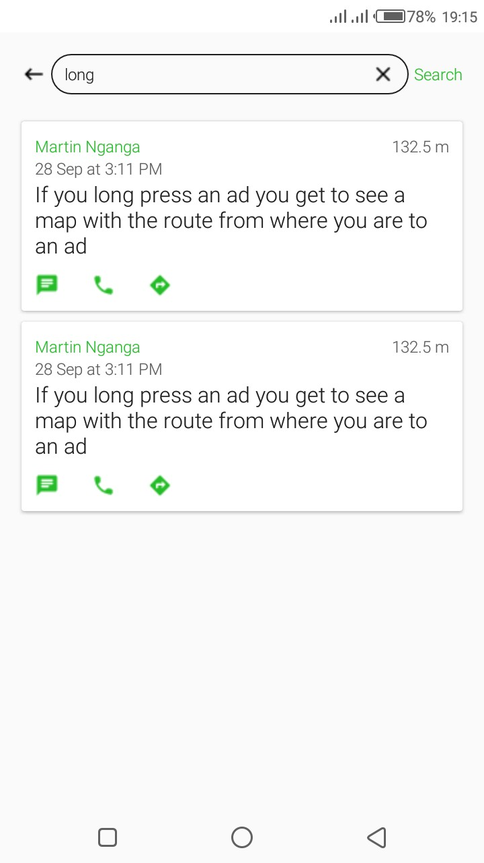
Results: Objective Two (Development)

Slide 15
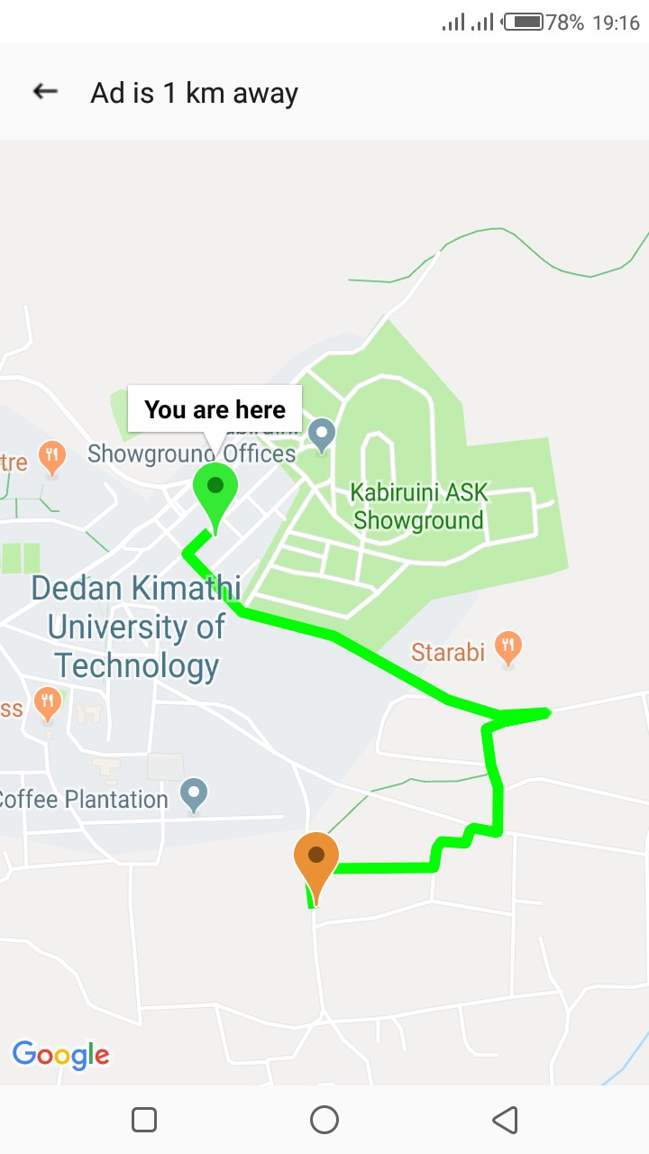
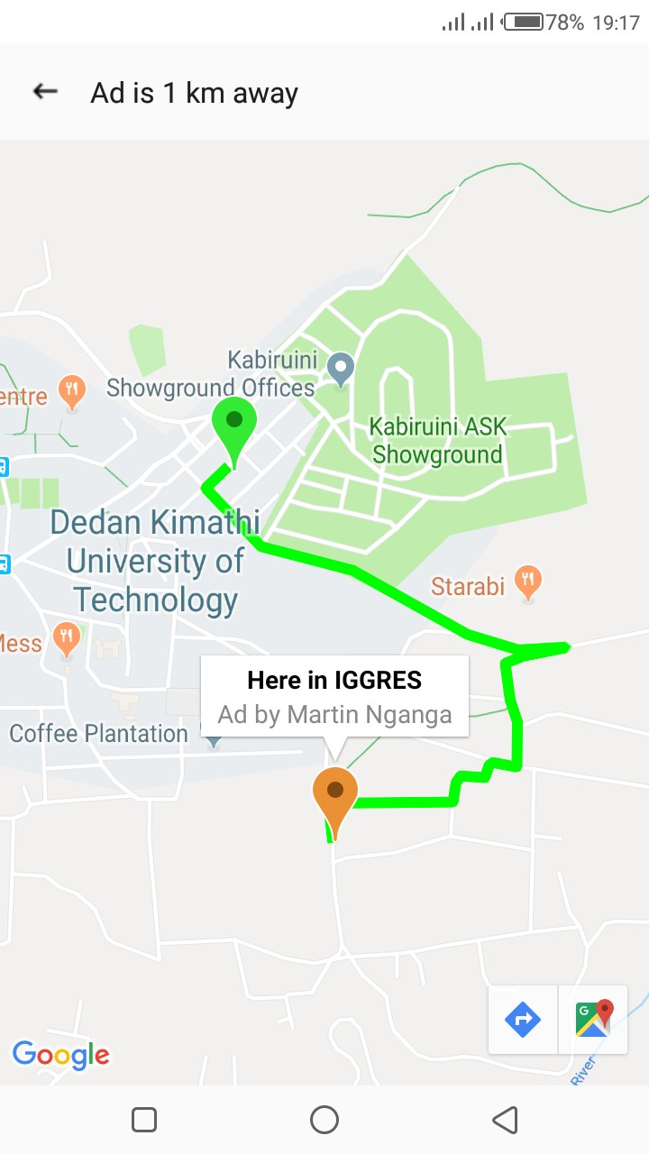
Results: Objective Two (Development)

Slide 16
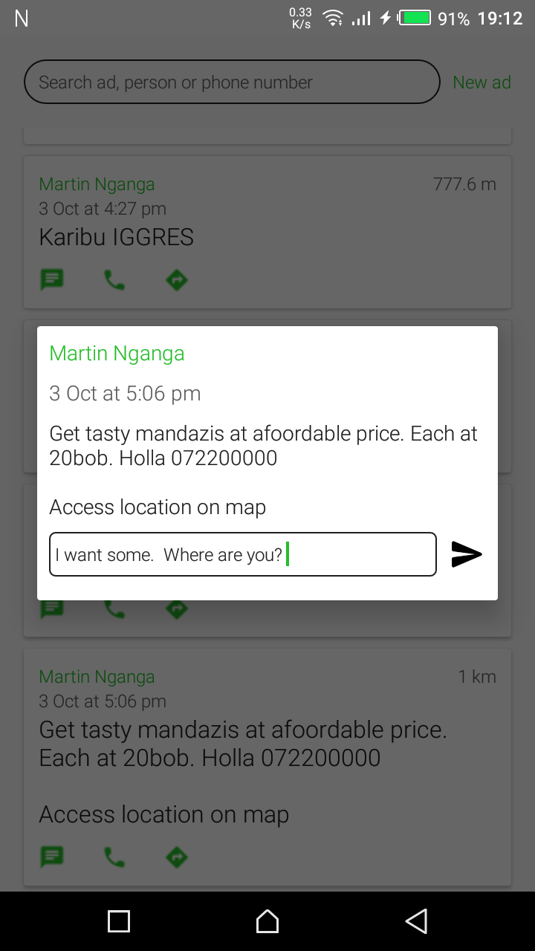
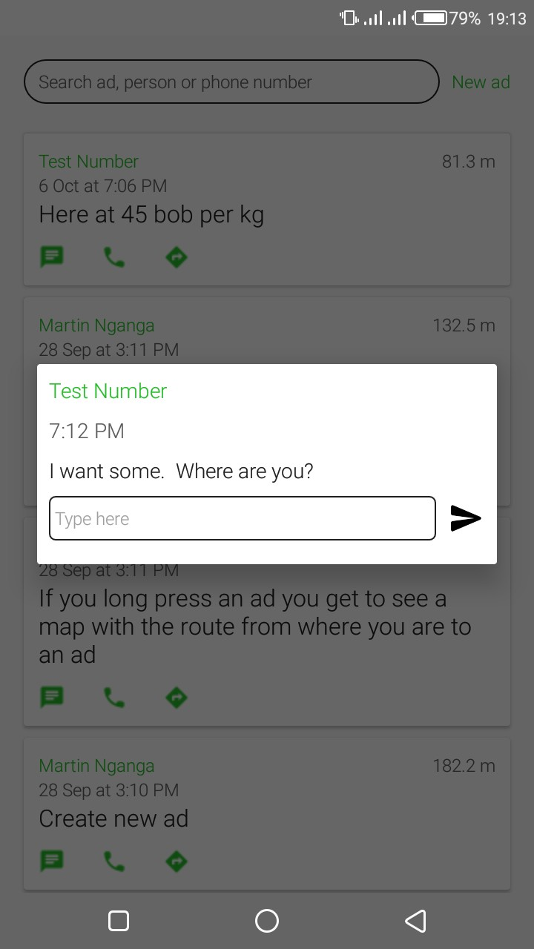
Results: Objective Two (Development)

Slide 17
Results: Objective Three (Assessment)
P2P Messaging - Unstable Internet Connections
Text Advertisements - Multimedia Advertisements
Indoor Positioning - Accuracy + Delay
Location Privacy

Slide 18
Conclusions
LBA - Simple Navigation; Easy to Create & Search Geotagged Ads
Opportunity - Promotion to a Large Mass of Small Vendor
Recommendations
Multimedia Advertisements
P2P Messaging in Unstable Internet Connections
Location Privacy + Accurate Indoor Positioning

